Slide 1
India’s Trusted B2B E-Commerce Platform

Slide 2
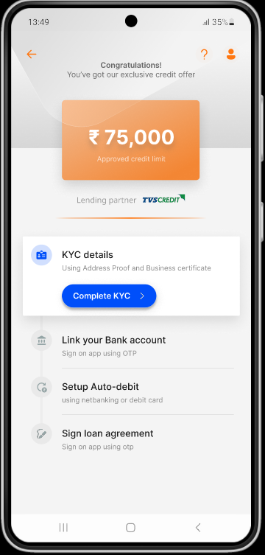
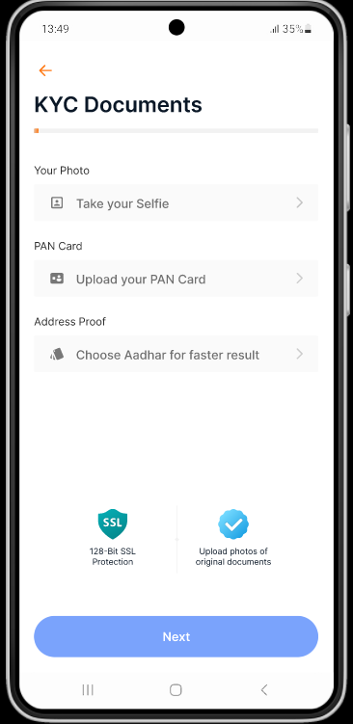
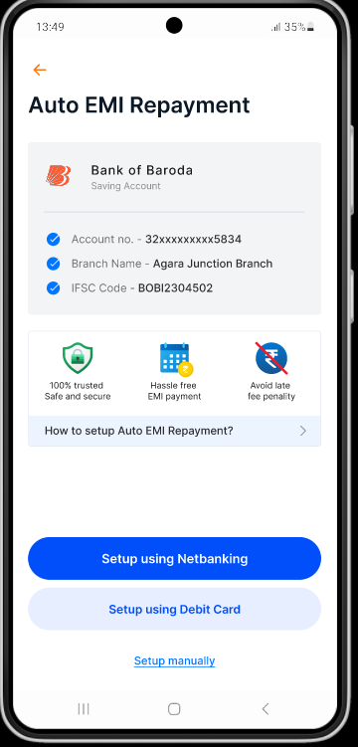
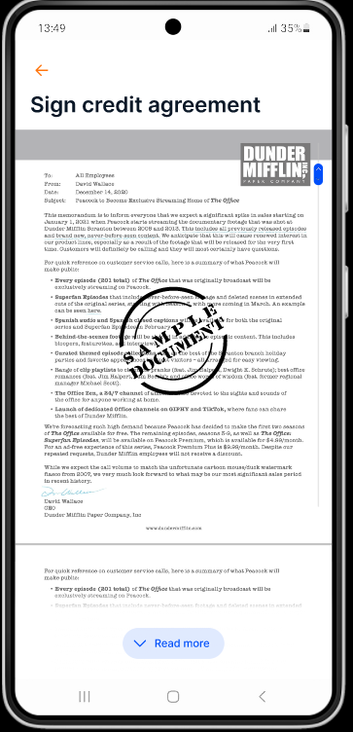




Buy Now Pay Later
Onboarding
Currently not on SOLV India App
Done upon FI Platforms
Credit Score and Routing logic
ONBOARDING
PayLater Interest
Buyer
KYC & Financial data*
Details
* Financial Documents pulled from source used for credit scoring and onboarding
1
2
5
4
3
FI Partner
Activation
Decisioning
‹#›

Slide 3
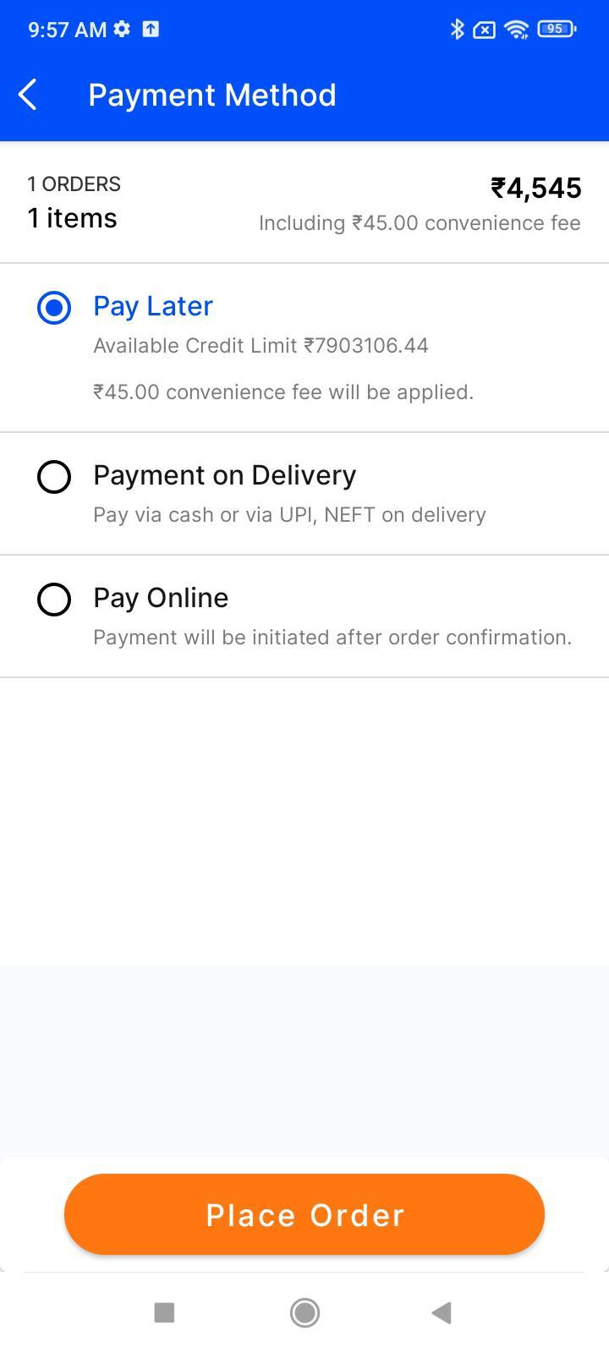
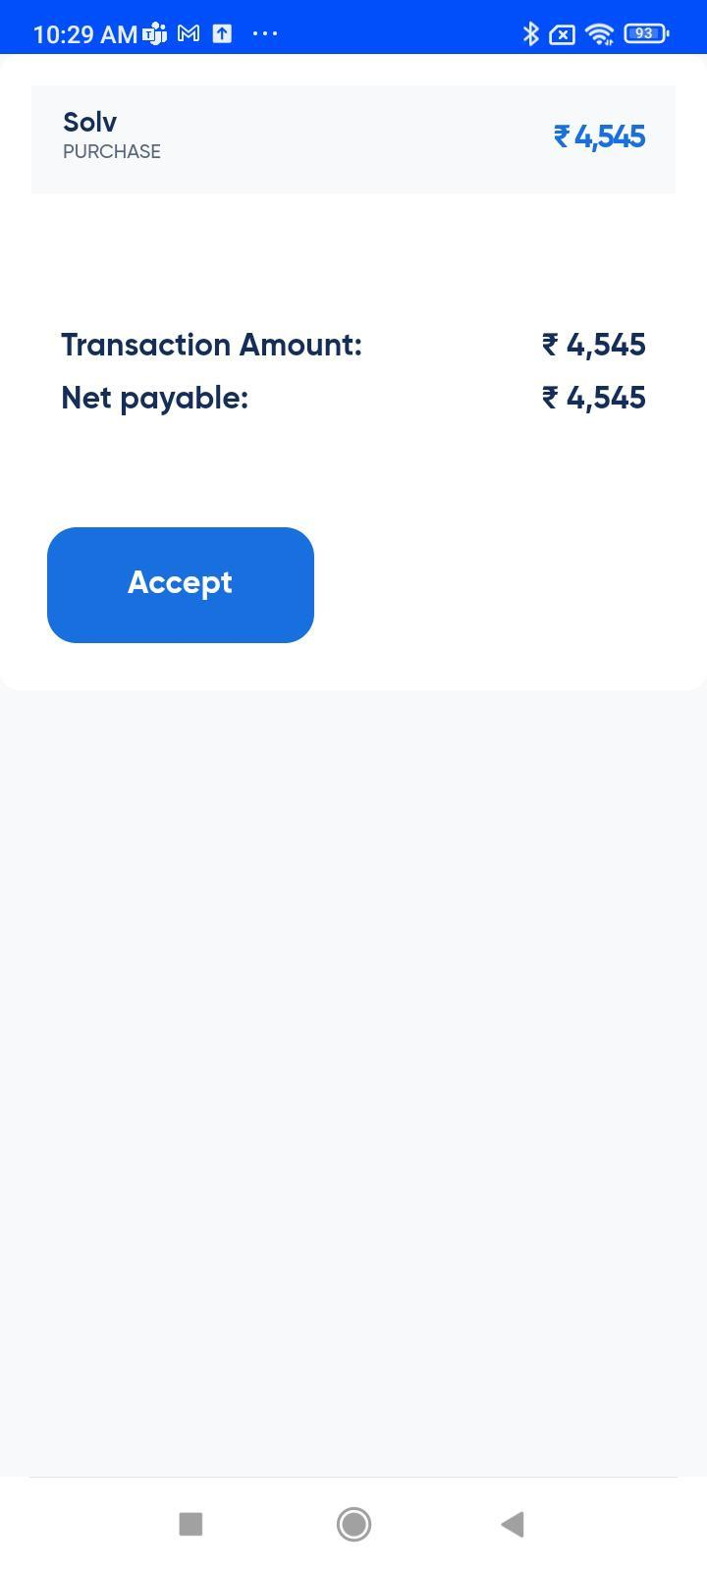
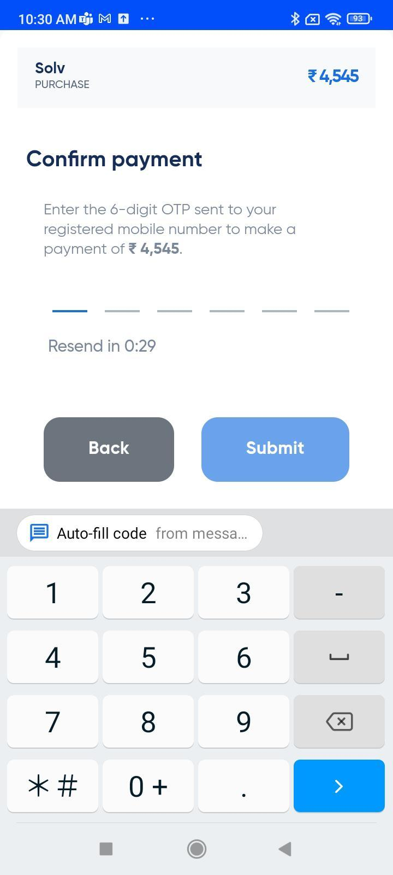
Buy Now Pay Later
Transaction
Buyer
Select PRODUCT
OTP Based Checkout
Checkout via Pay Later
TRANSACTION
1
2
3
FI Partner
‹#›

Slide 4
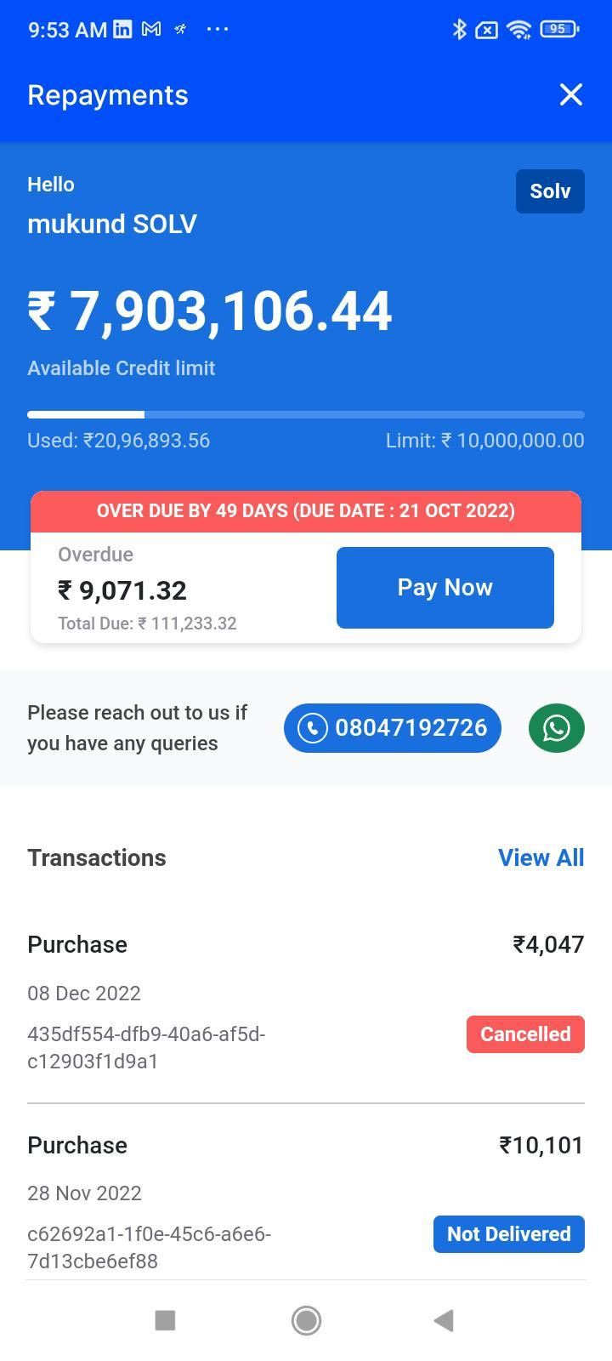
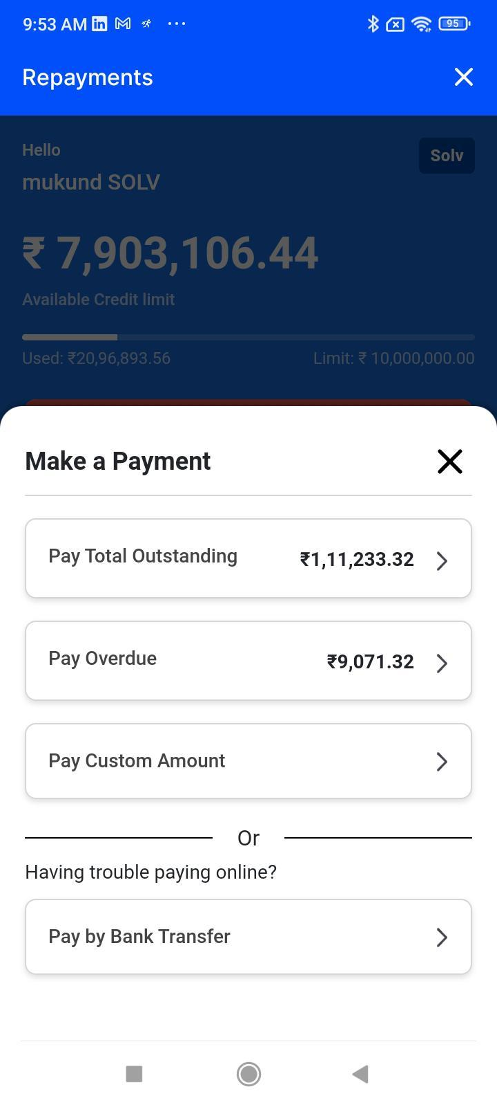
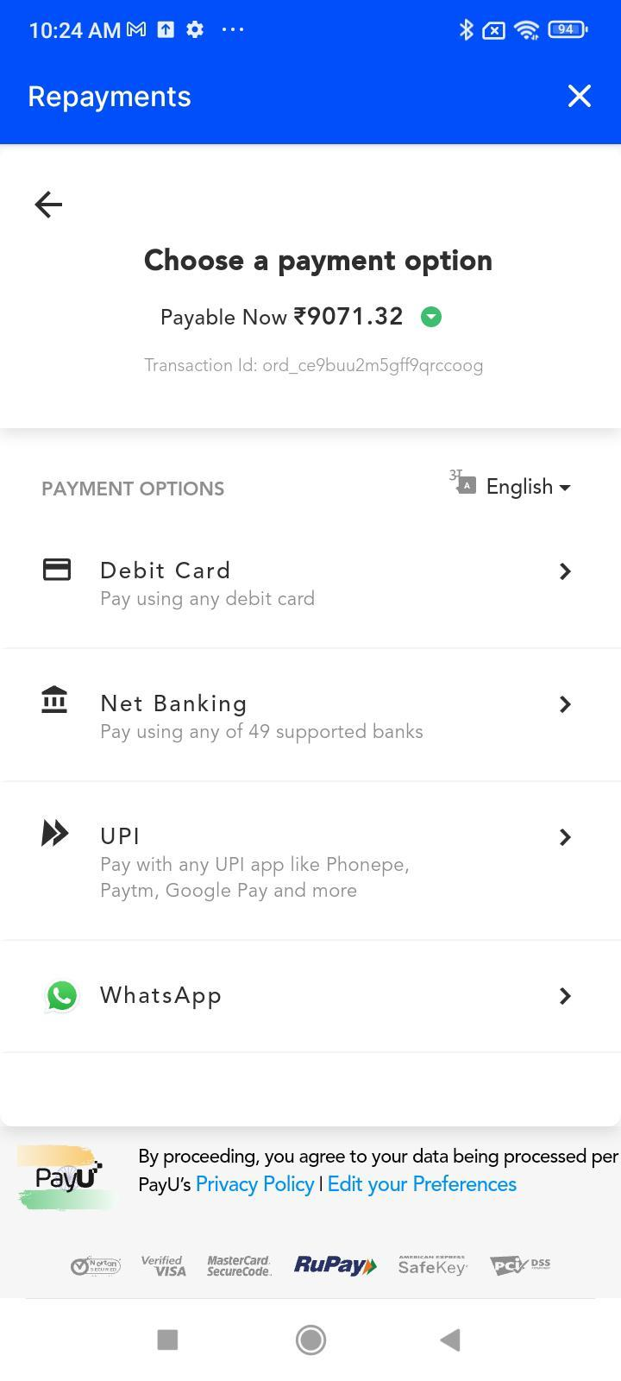
Buy Now Pay Later
Repayment
Checks PASSBOOK for DUEDATE
Buyer
Select DUE PAYMENT
PAY received by FI
REPAYMENT
1
2
3
FI Partner
‹#›

Slide 5
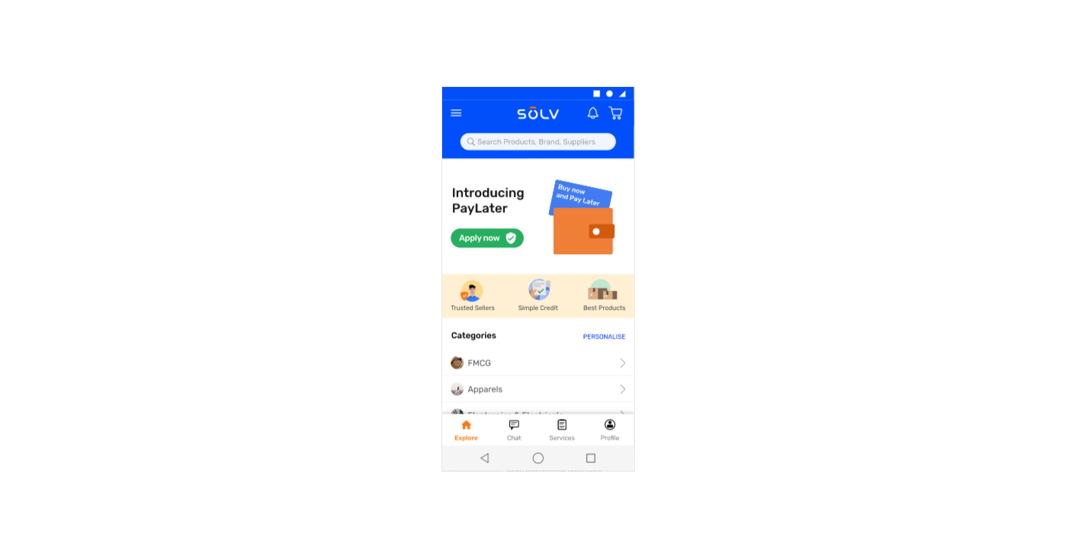
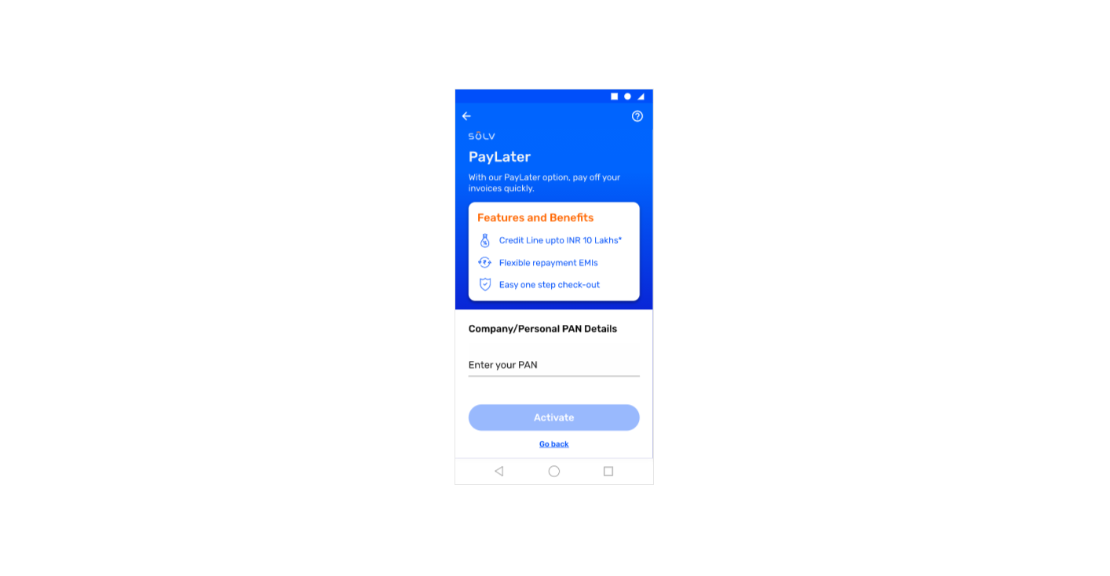
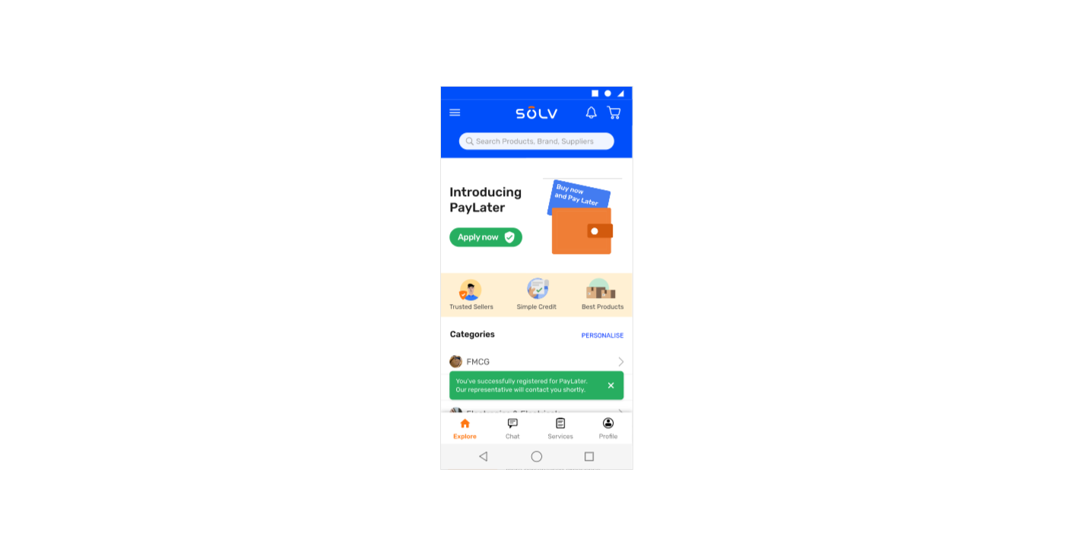
BNPL
Service call back request for activation
Currently we don’t take PAN CARD just the interest in callback

Slide 6
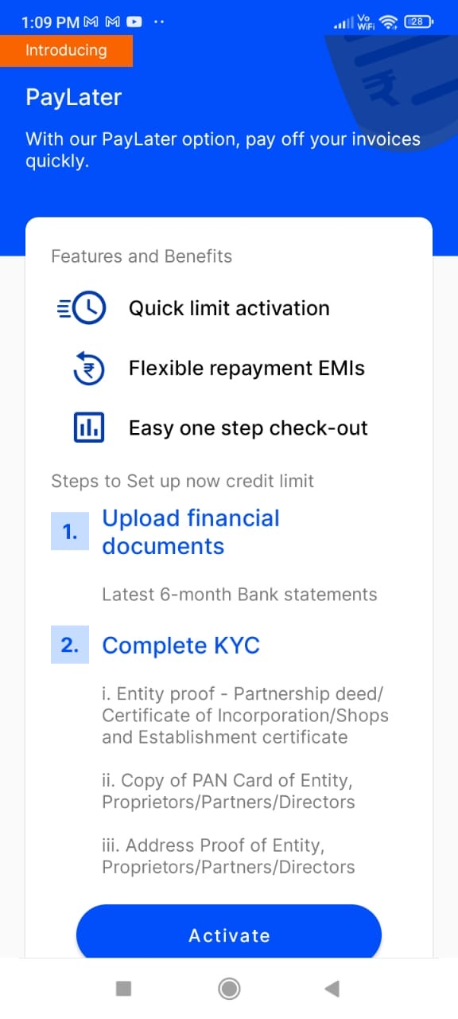
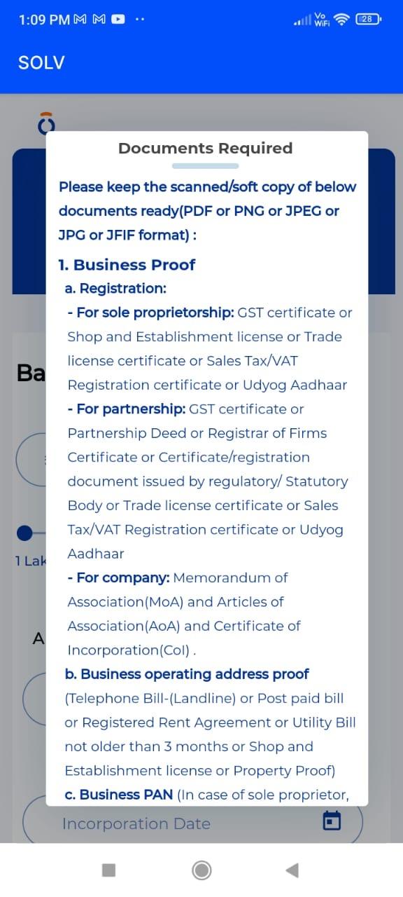
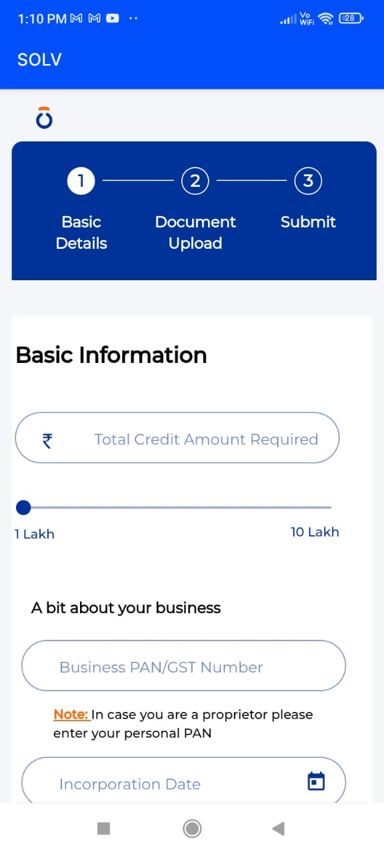
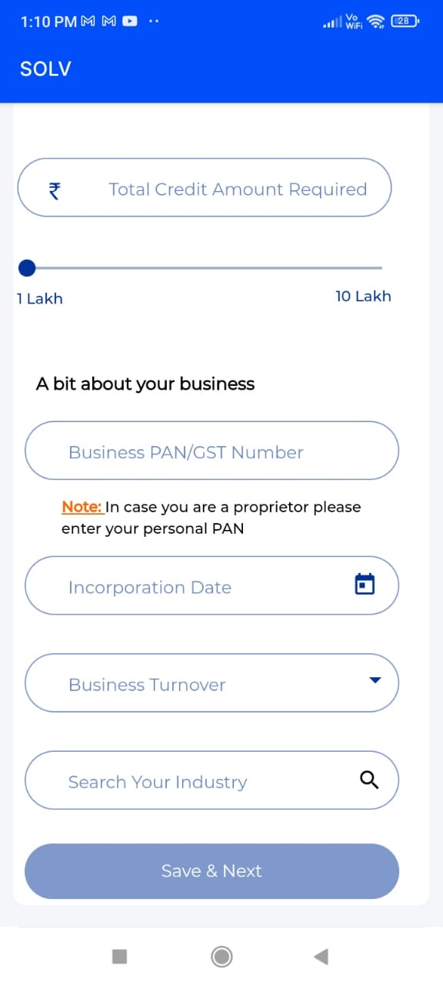
BNPL – Lending Journey
Onboarding Journey – via App
STEP 1 : Basic Information
Basic Information, we gather are
Total credit amount required
Business PAN / GST Number
Incorporation Date
Business Turnover
Industry

Slide 7
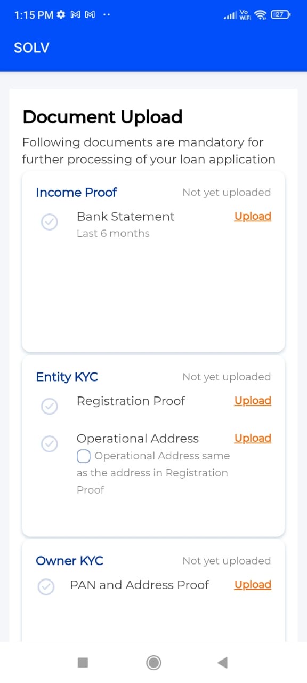
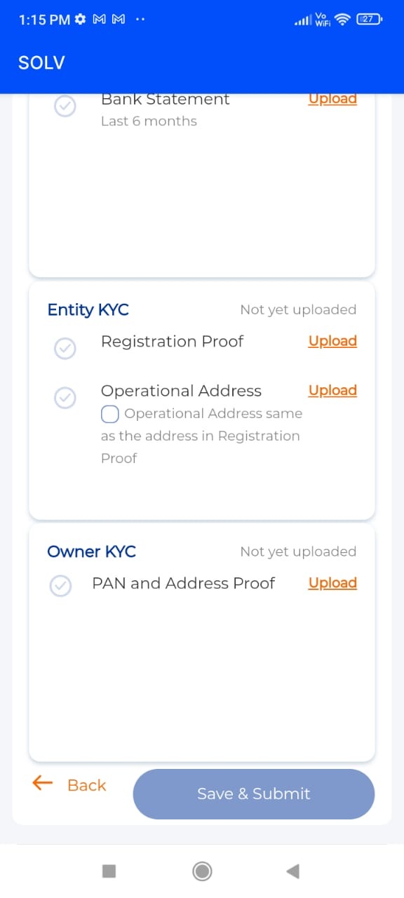
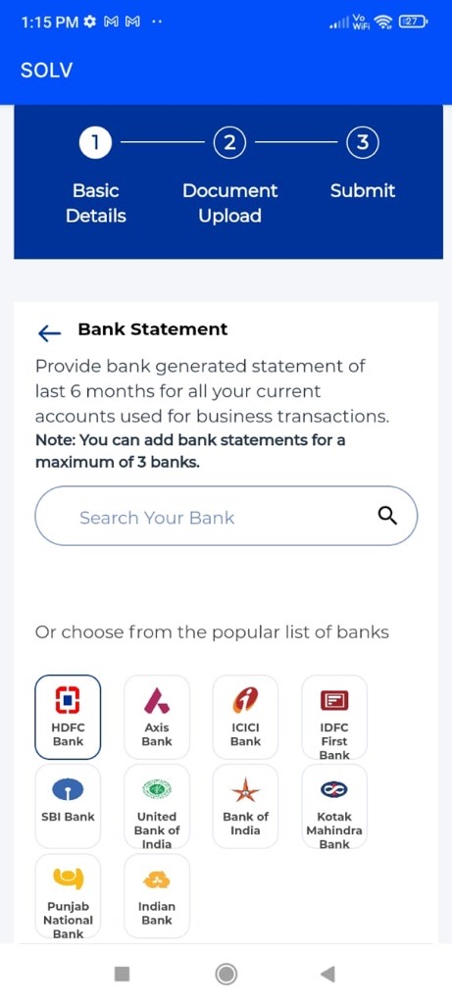
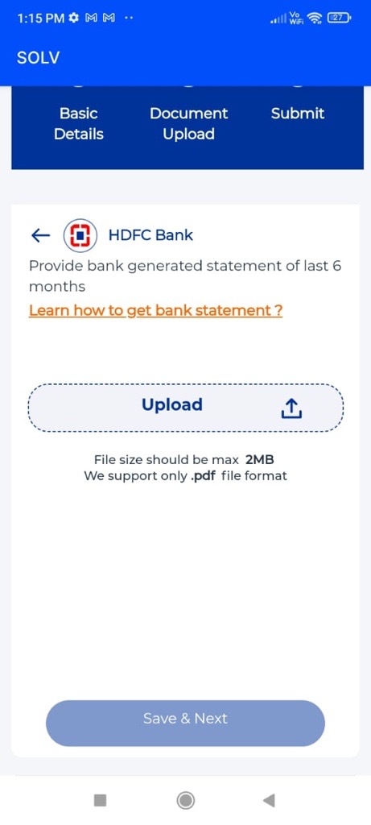
BNPL
Onboarding Journey
STEP 2 : Document Upload
Currently upload docs is DIS-FUNCTONAL

Slide 8
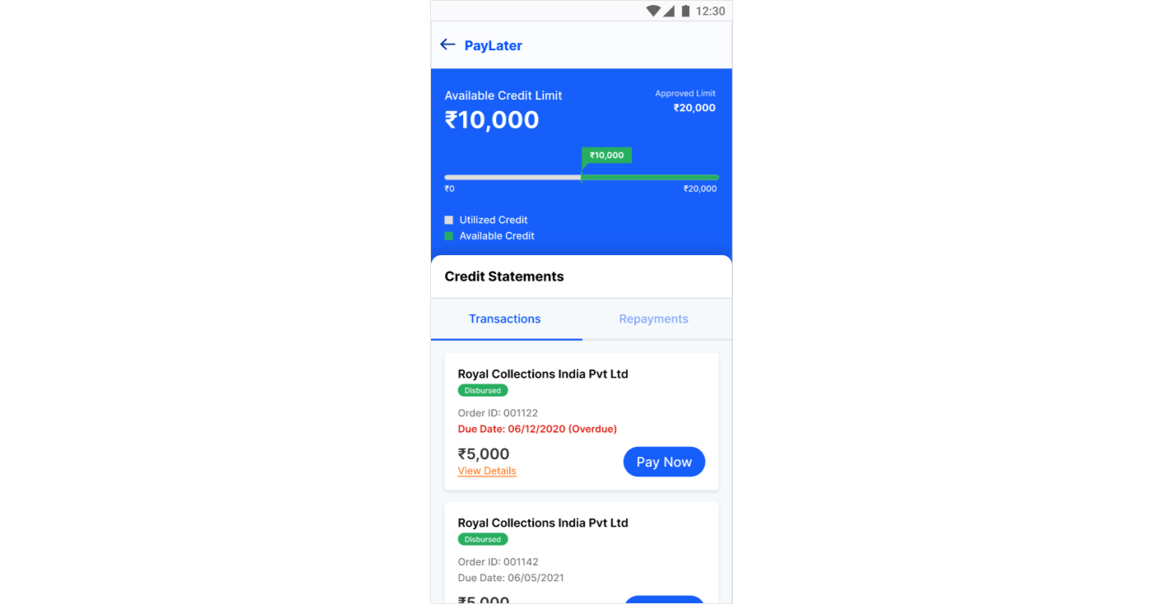
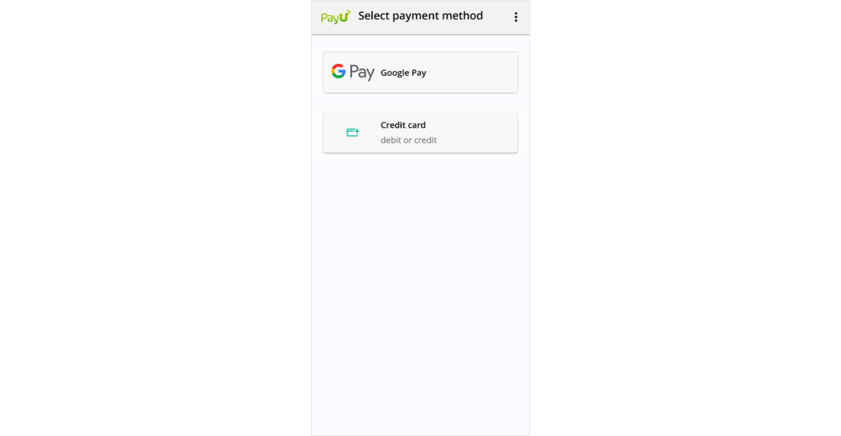
BNPL
Passbook & Repayment
Repayment currently is redirection to FI collection page
Notes:
Repayment currently is redirection to FI collection page

Slide 9
BNPL
EpayLater & Rupifi Onboarding Documents
# | Particulars
KYC
1 |  | PAN
2 |  | Adhaar Front
3 |  | Adhaar Back
4 |  | Passport Size photo
B-KYC
1 |  | GST 3 Pages
2 |  | Labour License
3 |  | Shop establishment
4 |  | Food and drug license
5 |  | FSSAI
6 |  | Weight and Measurement License
7 |  | Weight and Measurement Renewal License
8 |  | Owner photo with Shop name in Background
9 |  | Bank Statement | EpayLater Only
10 |  | E-Mandate / Nach ( via Adhaar ) | EpayLater Only

Slide 10
 | Onboarding Journey
# | Particulars
 | Personal Info
1 | PAN Number
2 | Email ID
3 | Fetch and Validate PAN Details
4 | Pin code
5 | DOB
6 | Gender
7 | Mobile Number ( Fetch and Validate )
8 | Consent
9 | OTP Consent
10 | Fetch Credit Score
 | Business Info
1 | Type of Business
2 | Business Name
3 | Date of Incorporation
4 | Annual Income Range ???? Revenue
 | Bank Statement Upload
1 | Bank Connect by Finbox
2 | Select Bank
3 | Netbanking ( user & password )
4 | Bank Statement 6 Month (PDF)
 | Offer Limit
 | Personal Info
1 | Educaton Level
2 | Father's Name
3 | Martial Status
4 | Confirm Address
5 | Ownership Type ( Owned / Rented )
 | KYC
1 | Selfie
2 | PAN CARD
3 | Address Proof
4 | Business Registration Proof
5 | Business Address confirmation
6 | Lender Assignment
7 | E-sign
8 | eMandate/NACH
BNPL
Finbox Onboarding

Slide 11
 | # | Particulars
 | STEP 1
 | 1 | Prequalification
 |  | Eligibility
 | 1.1 | Push Data to LOS for Eligibility Check
Field depends upon Business Loan/Personal Loan/BNPL/ Others |  | -SOLV ID
 |  | -PAN Number
 |  | -Mobile Number
 |  | -Business Registration Date
 |  | -GMV Data ( 6 months :: Value and Order :: MoM )
 | 1.2 | Eligibility Response
 |  | No
 |  | Yes
 |  | - Proceed for LOS journey
 | 2 | Basic Information
 |  | If PreQualification doesn’t populate all the required fields
 | 1 | Business PAN/Personal PAN Number (prefilled from SOLV onboarding)
 | 2 | Turnover
 | 3 | Business Category (prefilled from SOLV onboarding)
 | 4 | Other (as a part of preQualification)
 | 5 | GMV/Platform Transaction data to be pushed ( if required by FI )
 | 3 | PreQualification Check
 |  | Unsuccessful
 |  | Successful
 |  | -Upto LIMIT to be displayed
 |  | Proceed with Document collection
 | 4 | Document Collection
 | 1 | PAN
 | 2 | Adhaar Card (Front/Back)
 | 3 | Business Proof
 | 4 | Shop Photo ( Inside & Outside )
 | 5 | V-KYC & Selfie
 |  |  | 5 | Loan Agreement or Offer
 |  |  |  | Rejects
 |  |  |  | - No Activation for BNPL
 |  |  |  | Accepts
 |  |  |  | - Activation for BNPL
 | 6 | Bank Statement/Details
 |  | - Upload 6 months bank statement
 |  | - eMandate/NACH for Auto repayment
 |  | * required in some of lenders or higher limits
 |  |  | 7 | Loan Agreement or Offer (T&C)
 |  |  |  | Rejects
 |  |  |  | - No Activation for BNPL
 |  |  |  | Accepts
 |  |  |  | - Activation for BNPL
BNPL
SOLV Onboarding (Proposed)

Slide 12
# | Particulars |  | Comment | Epaylater | Rupifi | Mintifi | Other FI??
KYC |  |  |  | Yes | Yes | Yes
1 |  | PAN
2 |  | Adhaar Front
3 |  | Adhaar Back
4 |  | Passport Size photo |  | ?????
B-KYC |  |  |  | Yes | Yes | Yes
1 |  | GST 3 Pages | Any one of these??
2 |  | Labour License
3 |  | Shop establishment
4 |  | Food and drug license
5 |  | FSSAI
6 |  | Weight and Measurement License
7 |  | Weight and Measurement Renewal License
8 |  | Owner photo with Shop name in Background |  | Yes | ?? | ??
9 |  | Bank Statement | EpayLater Only | Yes( for additional limit) | No | No
10 |  | E-Mandate / Nach ( via Adhaar ) | EpayLater Only | Yes | No | No

Slide 13
BNPL
Designs for BNPL flow
# | Design for BNPL Onboarding on SOLV commerce app | Description
1 | https://xd.adobe.com/view/84dc0205-731e-48e6-44ad-651924f2b0cb-f2ed/ | Not working
2 | https://xd.adobe.com/view/6c9f2e82-bae2-49b9-879a-a0a88b90d951-39cc/ | SOLV app to BNPL pop up page
3 | https://xd.adobe.com/view/5d323a8f-712c-4a4d-bbc5-f57621154c5a-0861/ | Onboarding document collection via SOLV app flow
4 | https://xd.adobe.com/view/46089d69-eeb1-442b-967d-7fe9543018de-135b/ | multiple owner add and verify
5 | https://xd.adobe.com/view/fa9740b0-96ad-470c-941f-0943e3abf81b-afc4/ | intermediary progress status of BNPL application
6 | https://xd.adobe.com/view/cf409dbe-0c23-4f5e-a994-065025f66a69-9a13/ | call back request for BNPL activation
7 | https://xd.adobe.com/view/6c9f2e82-bae2-49b9-879a-a0a88b90d951-39cc/ | Basic information (1/3)
8 | https://xd.adobe.com/view/0cae11ac-dd86-40a1-b09c-416fc35fde5b-59fd/ | Full BNPL Journey
9 | https://xd.adobe.com/view/e0d56612-5a36-4151-adbf-30c518e41510-b586/ | BNPL Passbook
10 | https://xd.adobe.com/view/e0d56612-5a36-4151-adbf-30c518e41510-b586/ | Repayment journey

Slide 14
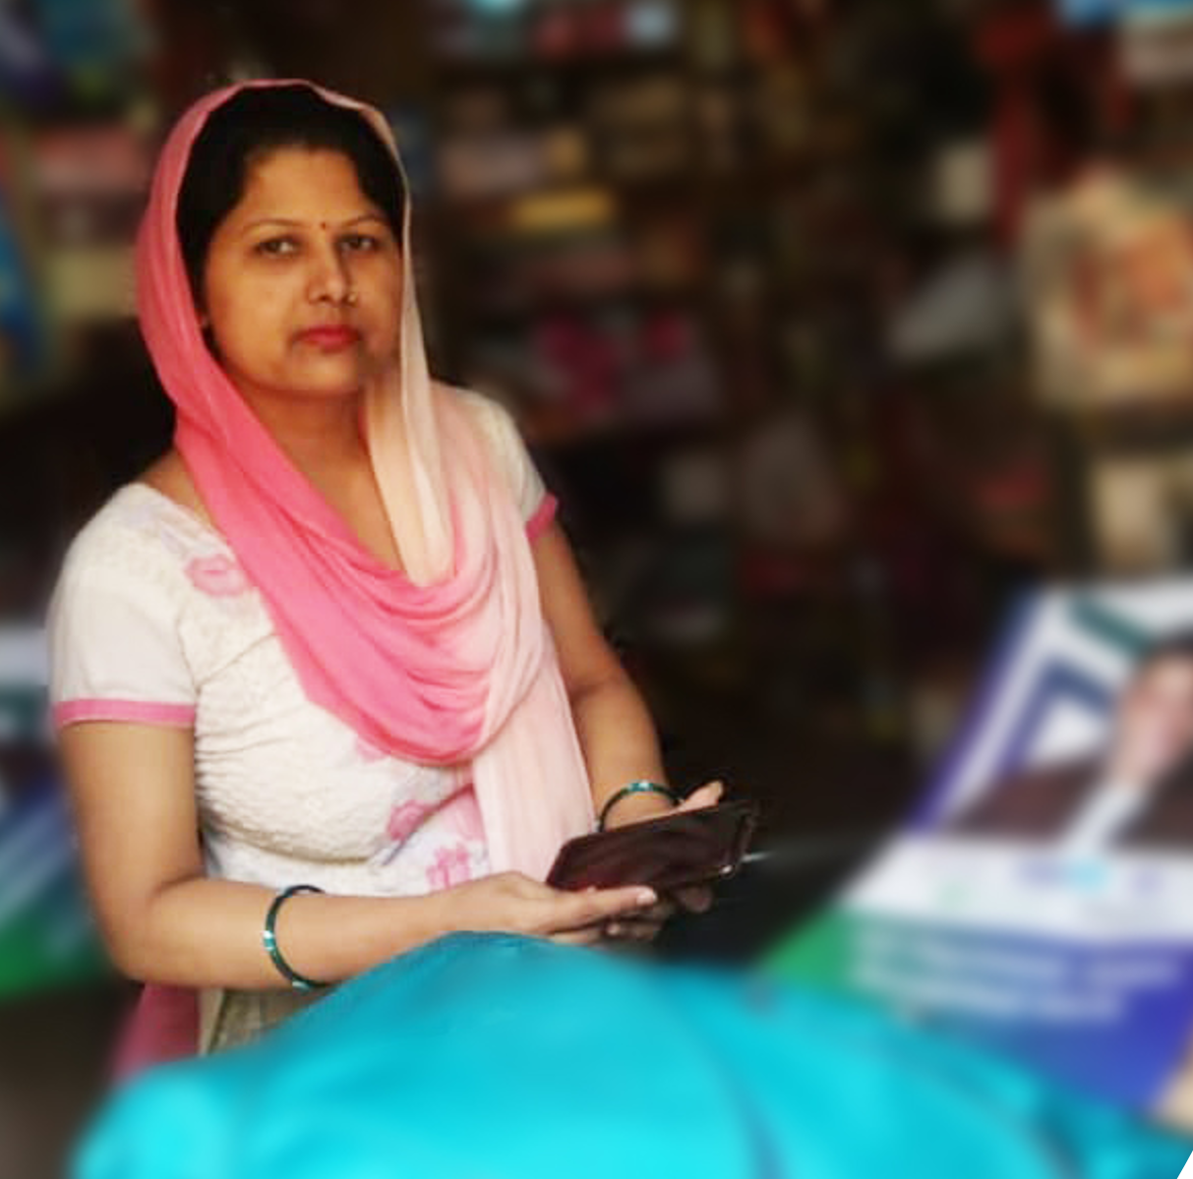



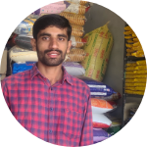


Gari Hersuru
Small Business Owner &
SOLV’s Customer
Let’s Help Millions like Gari Simplify Growth!
Visit us at
www.solvezy.com
Hear it straight from buyers and sellers on the SOLV platform
‹#›
‹#›

